Slide 1

SIEMENS JOB SIMULATION
Internship Completion
Report
Operations Industrial Engineer Simulation
Intern Candidate: Rishabh Mishra | Platform: Forage | Date: September 20, 2026

Slide 2

Program Overview
Practical industrial engineering simulation focused on operational excellence, time study methodologies, and shop floor layout optimization.

Slide 3


Program Scope & Context
Hands-On Experience
•
Simulated practical engineering challenges directly modeled after Siemens operational workflows.
•
Focused on evaluating assembly line efficiency, bottleneck detection, and ergonomic improvement.
•
Utilized standardized industrial engineering tools to propose data-backed plant enhancements.
•
Issued and authenticated via Forage in collaboration with Siemens leadership.

Slide 4






Core Engineering Tasks
Time Studies
Layout Changes
Process Optimization
Analyzed task durations and cycle times across operational steps to establish baseline time standards and line balancing.
Designed and proposed facility layout modifications to streamline material flow and minimize transit inefficiencies.
Applied Lean manufacturing techniques to enhance workplace ergonomics and boost total production throughput.

Slide 5
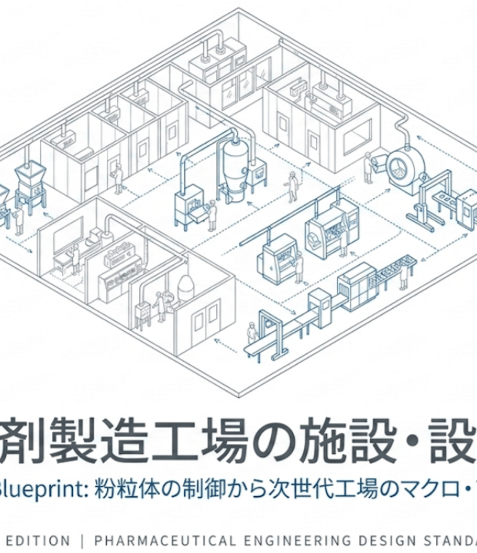
Facility Layout Planning
Strategic Shop Floor Design
The proposed layout modifications aimed to optimize the spatial arrangement of machinery, assembly stations, and raw material storage.
Key outcomes included reduced worker travel distances, safer material handling paths, and improved ergonomic positioning for line operators.

Slide 6
Key Program Impact
100%
Operational Proficiency Achieved
Successfully verified competency in conducting rigorous industrial time measurements and presenting layout transformation plans suitable for high-tech manufacturing environments like Siemens.
Modules Successfully Completed

Slide 7
Key Learnings & Methodology
Cycle Time Measurement: Learned standard work timing techniques to eliminate non-value-added activities (Muda) on the line.
Material Flow Streamlining: Mapped assembly pathing to identify congestion points and reduce part transfer lag.
Ergonomic & Safety Standards: Ensured proposed shop floor modifications adhere to industrial health and safety standards.
Executive Presentation: Synthesized technical findings into structured engineering proposals for management review.

Slide 8
Credential Verification
Parameter | Verification Information
Candidate Name | Rishabh Mishra
Simulation Title | Operations Industrial Engineer Job Simulation
Issuer & Host | Forage | Siemens
Enrolment Verification Code | 6aaf8ccd8b93e7892aecbfe4
User Verification Code | 6aaf8c43d1b8813a4b4121df
Authorized Signatory | Tom Brunskill (Co-Founder of Forage)

Slide 9
Thank You!
Questions & Discussion
Verified Certificate ID: 6aaf8ccd8b93e7892aecbfe4 | Siemens & Forage (2026)

Slide 10


Image Sources
https://images.sw.cdn.siemens.com/siemens-disw-assets/public/36Bh23LztCPIyYaOJUfL27/en-US/Car-Factory-3D-Concept-Automated-Robot-Arm-Assembly-Line-Manufacturing_v2.jpg?auto=format%2Ccompress&w=2560&h=1440&fit=crop&crop=faces%2Cedges&q=60
Source: www.siemens.com
https://assets.st-note.com/production/uploads/images/273113550/rectangle_large_type_2_28fd227c3575a565976453f510050fe6.png
Source: note.com

